Slide 1



Youth Performance Academy 2017

Slide 3
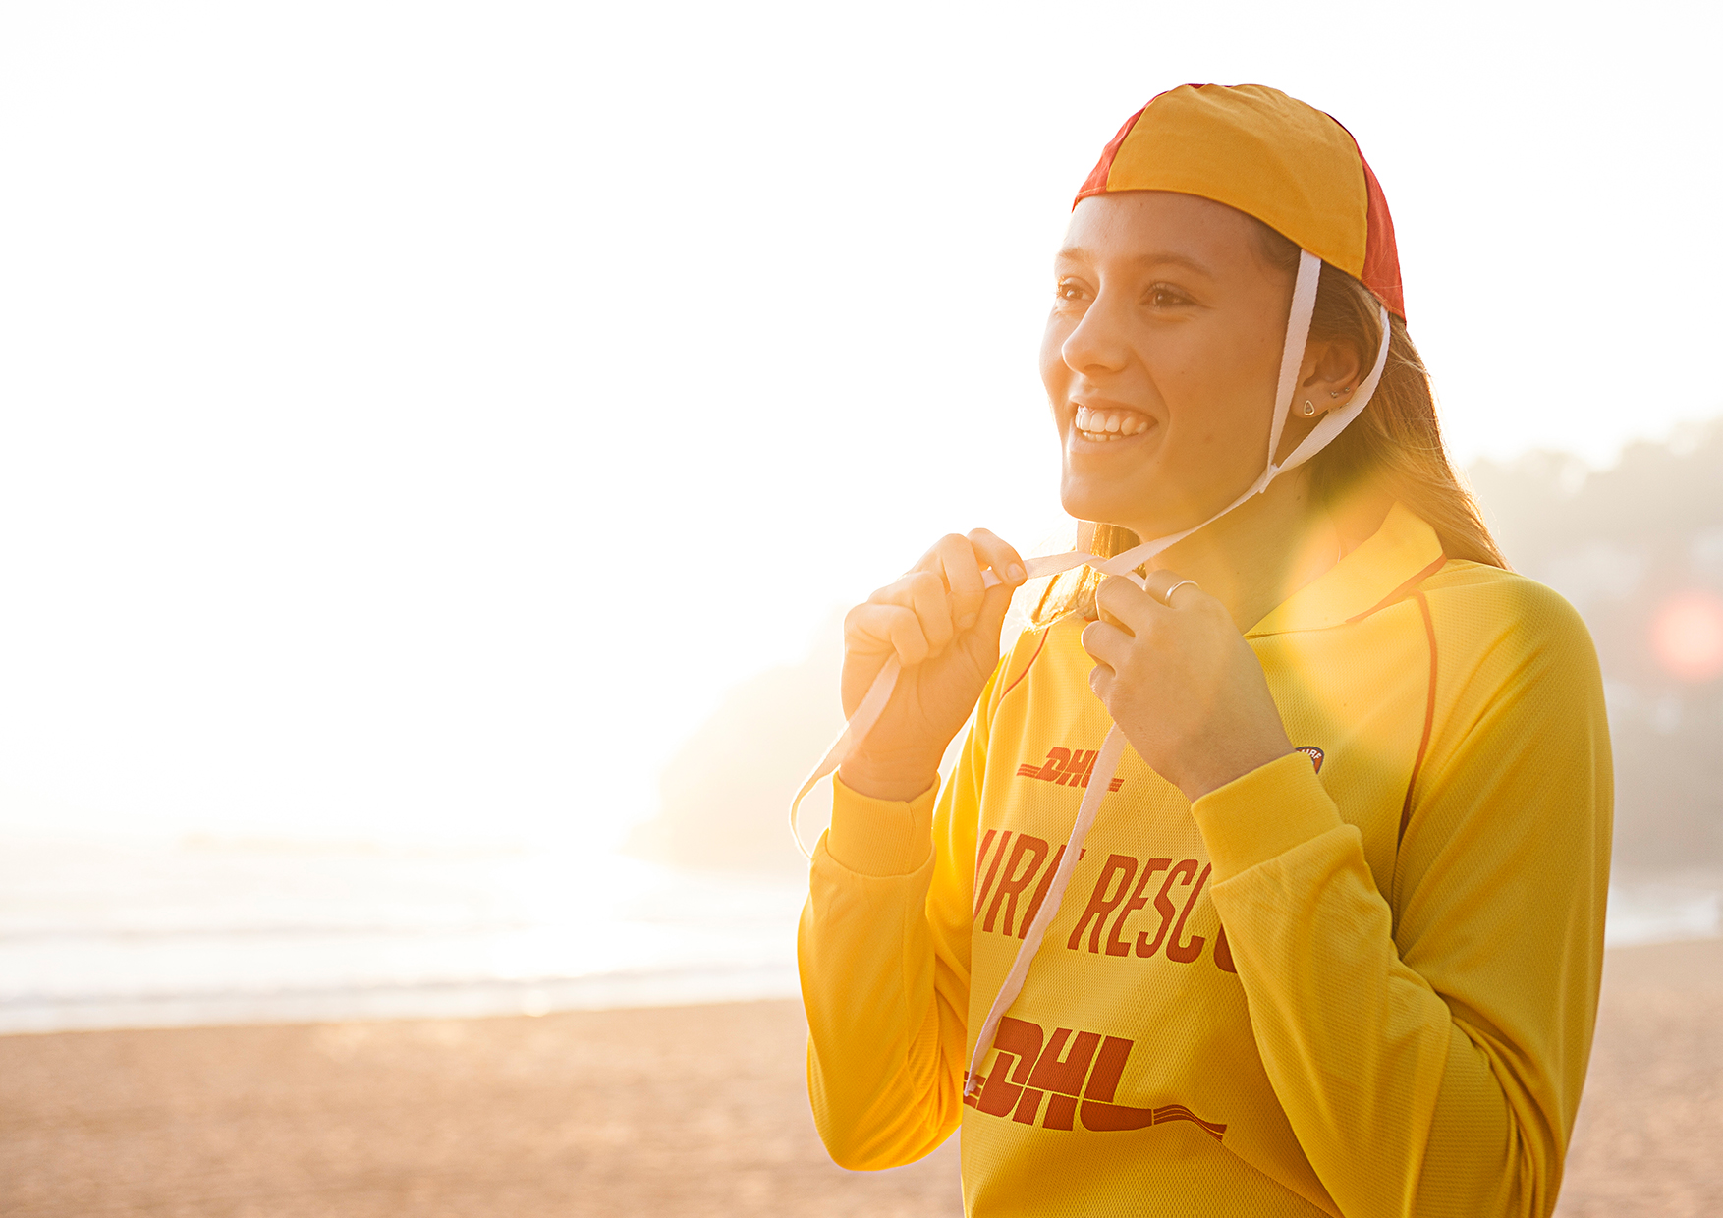
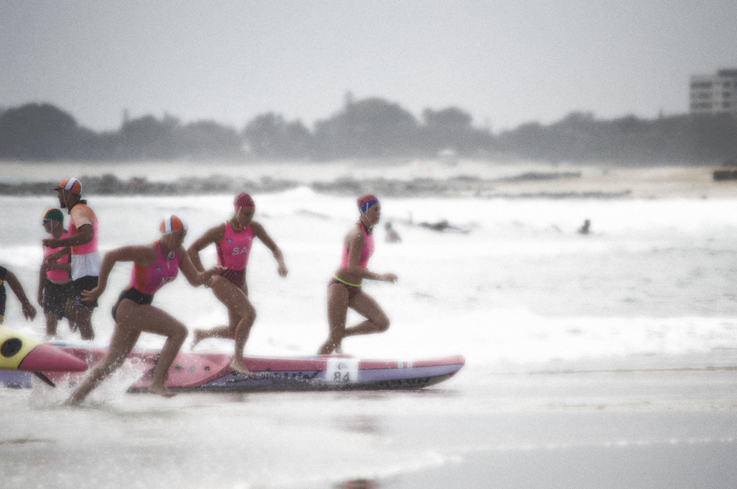
Athlete Pathways:
Opportunities & Sporting Landscape

Slide 4
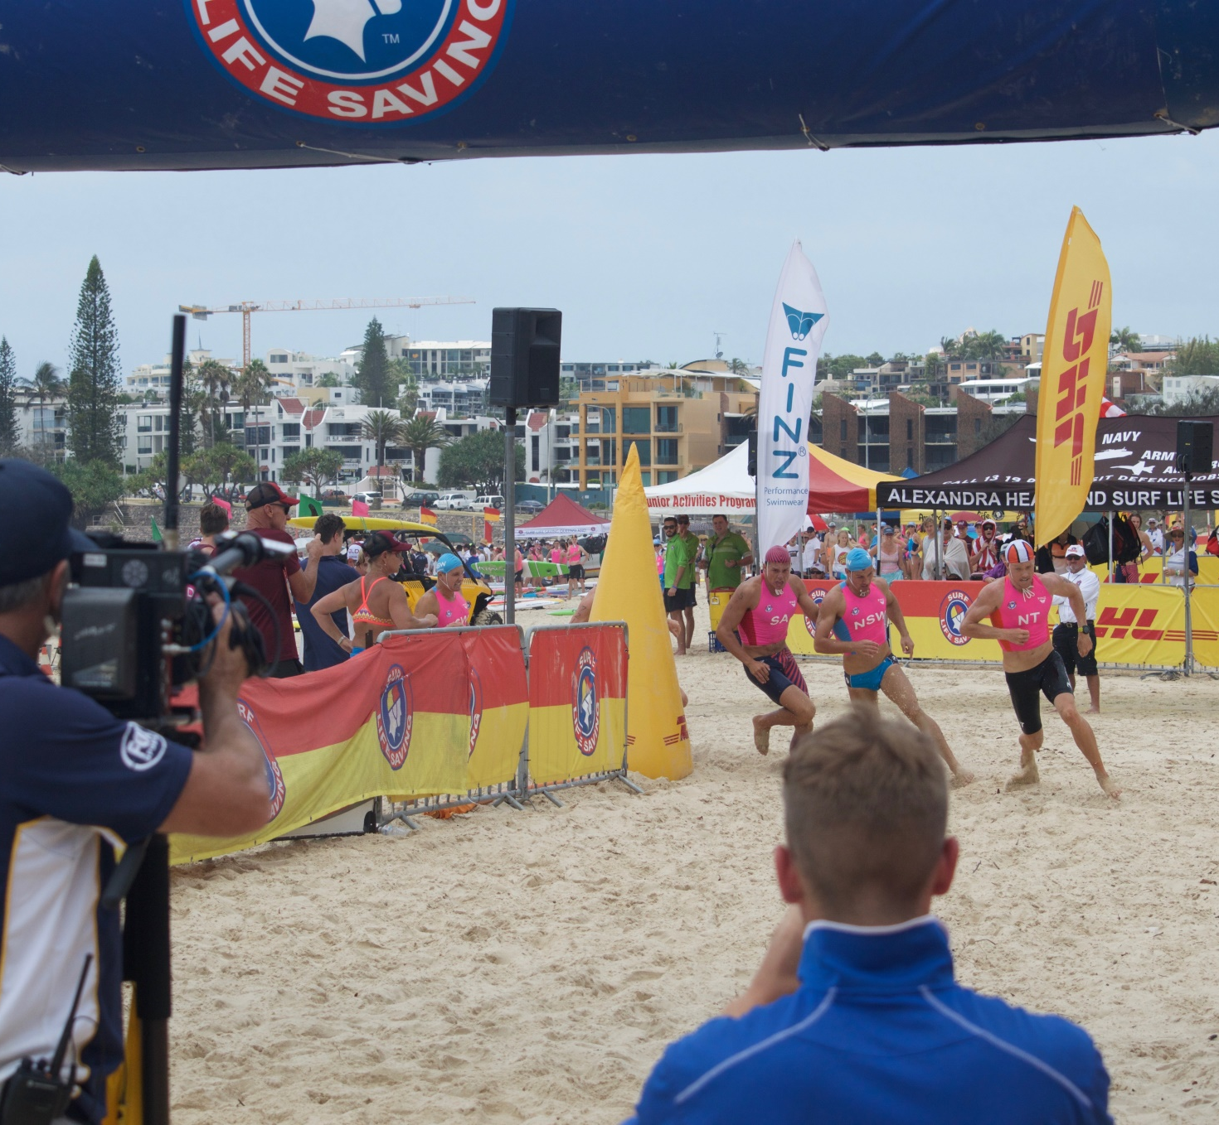
from nippers to the Australian national team
  Story time…
  What are the levels of competition to aspire to?
  What it takes to get there?
  How it’s done?

Slide 5
Goal Setting Task:
What has your pathway been so far?
How did you get into Surf Life Saving?
How did you get into Surf Sports?
What do you like about Surf Sports?
What do you want your pathway to be?
Anything is possible!

Slide 6
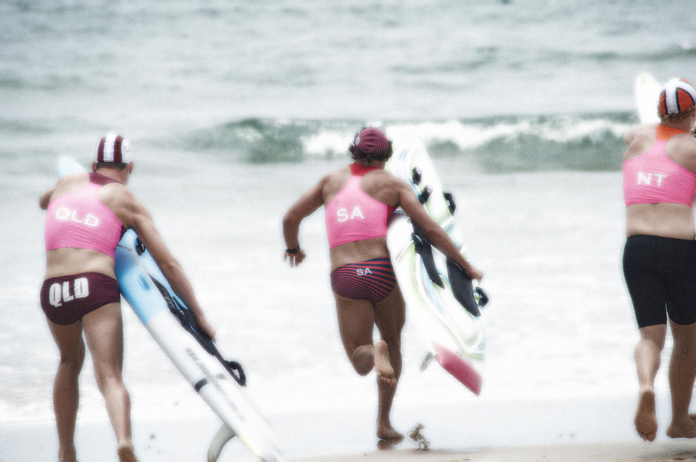
Athlete Workshop:

Slide 7
Goal orientation Task:
What sort of environment are you currently in with your sport? (Enjoyable, Challenging, Motivating, Competitive, Fun, Bad?)
Have you got the best environment around you in order to achieve what you want to achieve? (Yes, No, Maybe?)
Is it an “Elite” Environment?
What are the things that I could do to improve the environment around me? (Training Squad/Coaching, Equipment, Sports Science, Physio, Pilates, Nutrition, Recovery, Etc.)
Who’s going to help me or give me support? (Parents, Friends, Coaches, Peers, Mentors, Teachers, Club)

Slide 8
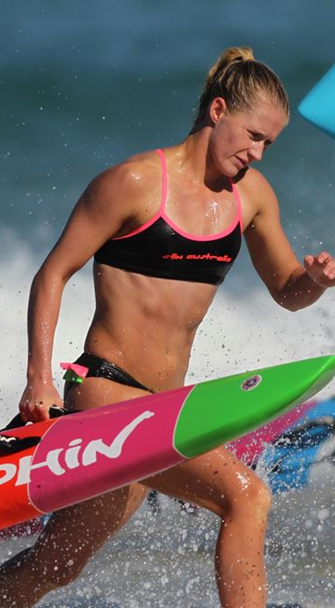
Athlete development:
  Various aspects of your sporting environment contribute to your overall athletic development.
  One way to sustain significant athletic development is to conduct regular testing. This ensures that you know that what you’re doing is working, and what areas need improvement. Testing can be in-competition or outside of competition.
  Significant areas of training and environment for athletic development are:
  Coaching philosophy & periodisation of training
  Training strategy
  Strength & conditioning
  Recovery
  Nutrition
  Psychology

Slide 9
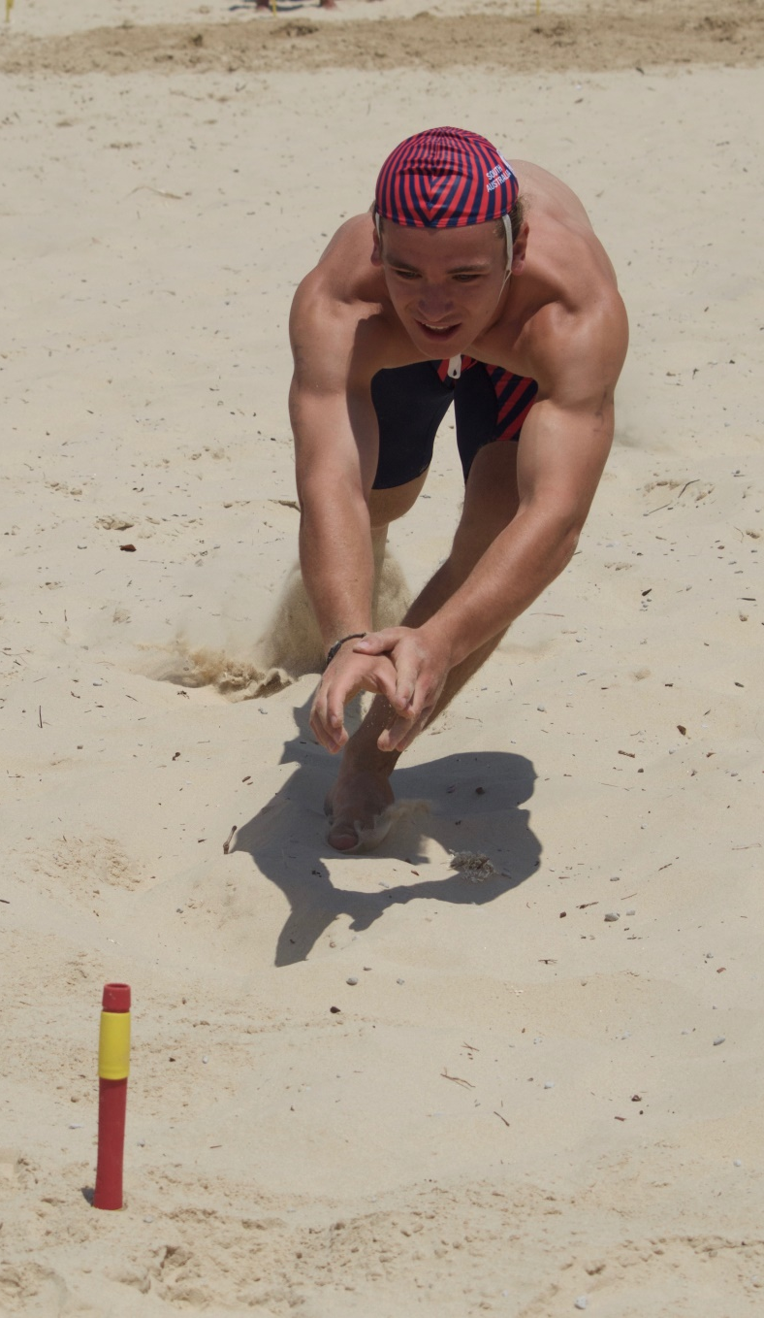
Strength & Conditioning:
Doesn’t just mean going to the gym and lifting weights.
You want to both increase your physical capabilities (Strength) but also increase your bodies resilience and capacity to train (Conditioning). Most people don’t condition their body to train better.
Weights (various ways to utilise)
Plyometrics
Stretching
Pilates
Yoga
Breathing Exercises

Slide 10
Recovery:
Crucial for your body to adapt to training, and to improve your capacity to train!
Better & faster recovery = Harder & increased training load.
SLEEP
REST & RELAXATION
COLD WATER SUBMERSION
FLOATATION TANK
MASSAGE
CRYOTHERAPY
COMPRESSION GARMENTS
NUTRITION
PHYSIOTHERAPY**
+ MORE

Slide 11
Nutrition:
Nutrition is crucial to athletic development and performance optimisation. (Help you to take your competing to the next level)
S.H.A.P.E. Nutrition sessions should be utilised! (Gives you access to resources and research that others don’t have)
**PRESENTATION & COOKING SESSION LATER ON.**

Slide 12

Mindfulness:

Slide 13

Mindfulness:

Slide 14

mindfulness exercise:

Slide 15
Academy Analysis & evaluation:
Have you enjoyed your time with the Academy so far?
What have you learnt?
Have you improved?
Have you changed anything?
Is there anything you dislike?
What would you change?
The Youth Performance Academy is designed to ensure you have everything you need to succeed!

Slide 16
Contacts:
Flinders University - S.H.A.P.E.
    S&C – Dr. Kym Williams
    Nutrition – Dr. Kathryn Jackson
    Psychology – Dr. Ivanka Prichard & Jennifer Cullen-Pascoe
    Exercise Physiology/Testing – Claire Drummond & Students
    S.H.A.P.E. Research Support Officer – Nadia Bevan
Academy & State Coaches
    Bly (Brian) Bayliss
    Craig Nicholson
    Sean McKenzie
    Francesca Kidd
    Lachlan Sheffield
    Caitlin Sheehy
Academy Coordinator - Blake Steele
blake.steele@surflifesavingsa.com.au
(08) 8354 6900

Slide 17
Surf Sports Youth Performance Academy Program Dates as at 18/09/2017
DATE | TIME | VENUE | DETAILS
23/09/2017 | 1:00pm-5:30pm | Surf Central | Youth Development Clinic
24/09/2017 | 9:00am-12:00pm | Mid/South Coast | Youth Development Clinic
29/10/2017 | 8:00am | TBC | Ocean/Beach Training Session
??/11/2017 | TBC (PM) | Tonsley Park | Information/Presentation Night
09/12/2017 | 8:30am – 11:30am | Flinders Uni | Testing Period #3
13/12/2017 | TBC (PM) | TBC | Social Activity #2

